Slide 1
State-Backed Information Operations Analysis using Pre-trained Transformer-Based Models
Presented by Guardians of the Twitterverse
Hailie Nguyen, Jon Ma, Yichen Shi, Ghana Shyam Bandi
12/13/2023

Slide 2

Problem Statement
Background:
Since October 2018, Twitter has disclosed data on potential foreign information operations:
Persistent platform manipulation campaigns (material that violated Twitter’s platform manipulation and spam policy).
Manipulation that Twitter can reliably attribute to a government or state-linked actor is considered an information operation (IO).
Objective:
Understand the narratives behind some of these operations.
Develop a generalizable approach to identify potential information operations.
https://transparency.twitter.com/en/reports/moderation-research.html
Notes:
Highlight the increasing prevalence of state-sponsored entities engaging in information operations
Emphasize the coordinated efforts involving fake accounts, disinformation, propaganda, and other deceptive tactics employed by governments or state-sponsored entities
Discuss how these operations are designed to shape narratives, creating a distorted version of events to influence public perception
Explore how the surge in social media and online platforms has provided a significant platform for state actors to execute and amplify their information operations.
Illustrate how these operations serve as a prominent tool for state actors to advance their geopolitical interests by manipulating public opinion
Discuss the wide array of activities involved, such as spreading false information, amplifying divisive content, and impersonating individuals or organizations
Critical to understand the scope and methods of state-backed information operations (IOs).
Emphasize the critical importance of understanding and countering these operations to protect the integrity of online discourse and safeguard the democratic foundations of the digital age

Slide 3
Data
Twitter Moderation Research Consortium:
Cohort of datasets categorized by operations and states (e.g., China, Russia).
10,000 to 100,000 tweets in each set.
Used as positive samples in analysis.
Random Twitter Dataset [1]:
1.6 million random tweets, mainly in English.
Diverse content reflects the varied nature of user-generated content.
Used as negative, non-IO related tweets, representing informal, personal content.
Diplomatic Discourse Online - Twitter [2]:
Tweets from 500+ Russian and Chinese diplomats.
Multiple languages.
Serves as a diplomatic, non-IO focused resource.
Combined with random tweets to form negative samples in the analysis.
[1] Majid Ahmad Khan. (2022). 1.6 million random tweets. Kaggle. https://www.kaggle.com/datasets/i191796majid/tweets
[2] Erhardt, Keeley, 2023, "Diplomatic Discourse Online - Twitter", https://doi.org/10.7910/DVN/2ET9PU, Harvard Dataverse, V1

Slide 4
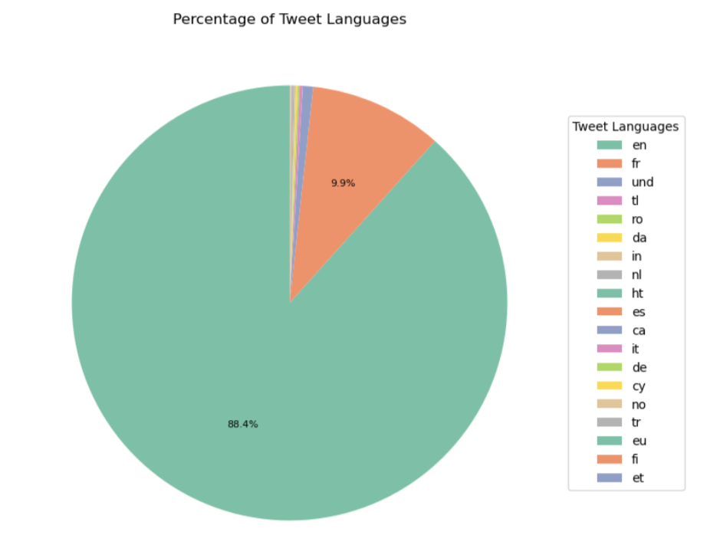
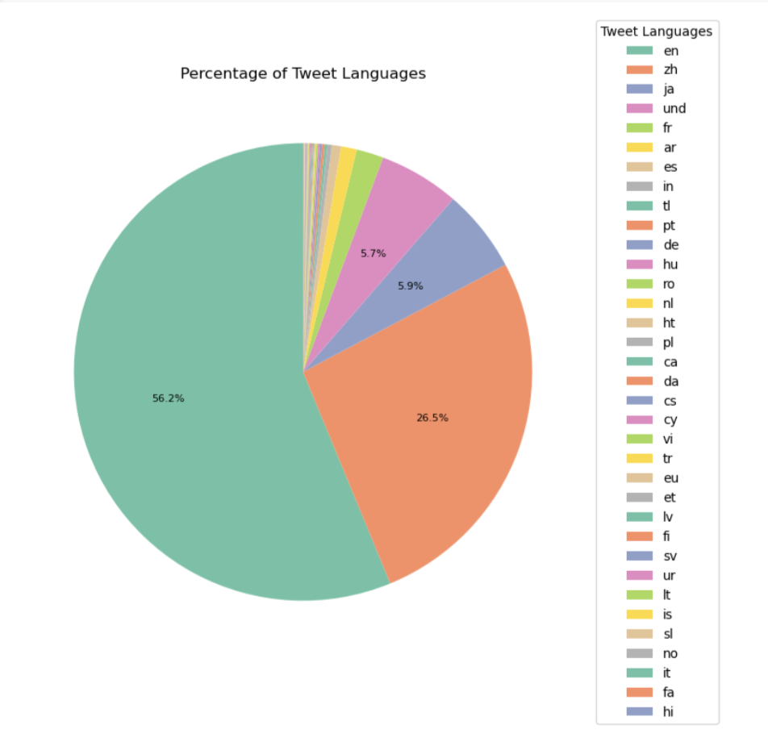
Setup
Training data:
Russia East Africa (REA)
7,721 tweets
88% English tweets
50 accounts
One-operation dataset (REA): 14k total
7K REA (IO)
3.5K sampled Random (non-IO)
3.5k sampled Diplomatic_Russia (non-IO)
Two-operation dataset (REA+CNHU): 4k total
1K sampled CNHU (IO)
1k sampled REA (IO)
1k sampled Random (non-IO)
500 sampled Diplomatic_China (non-IO)
500 sampled Diplomatic_Russia (non-IO)
China Xinjiang (CNHU)
31,269 tweets
56% English tweets, 26% Chinese
2,048 accounts
Figure 1. Percentage of Tweets by Language - REA
Russia North Africa (RNA)
18,681 tweets
61.9% English tweets, 17.2% French
16 accounts
Test data:
1K sampled RNA (IO)
500 sampled Random (non-IO)
250 sampled Diplomatic_China (non-IO)
250 sampled Diplomatic_Russia (non-IO)
Figure 2. Percentage of Tweets by Language - CNHU

Slide 5
Approaches
IO Classification/Detection
Training:
Ada:
Ada 0: One-operation (REA)
Ada 1: Sample of two-operation (REA+CNHU)
BERT:
BERT 0: One-operation (REA)
BERT 1: Sample of two-operation (REA+CNHU)
Test: RNA-based
IO Theme Extraction
Embeddings:
OpenAI’s text-embedding-ada-002
Clustering:
K-Means clustering
Theme extraction:
OpenAI’s text-davinci-003

Slide 6
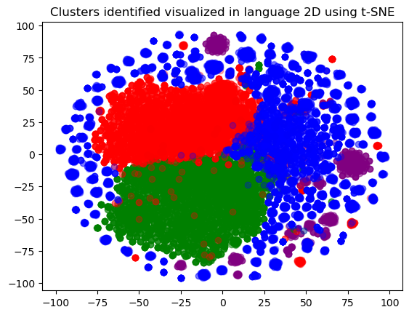
Results - Theme Extraction
Cluster | Theme | Sample Tweets
0 | Xinjiang's counter-terrorism measures protect human rights. | @ErkinSidick @Dolkun_Isa @Erkin_Azat @adrianzenz #Xinjiang’s counter-terrorism measures protect human rights https://t.co/pzp6NisIsC Xinjiang’s counter-terrorism measures protect human rights #xinjiang https://t.co/HQjWl6hONn
1 | Admiration for someone's remarkable memory and a celebration of nature's beauty. | 他有惊人的记忆力. https://t.co/1q3J1b9Etv 浊酒一杯温如言
2 | Hard work and appreciation for parents. | Whats on tonight Your parents are still working hard for you, this is the reason you strong today.
3 | Xinjiang is a safe and vibrant place, with a rich culture and history; efforts of the Chinese government to combat terrorism and extremism in the region. | CGTN documentary exposes terrorism, extremism in Xinjiang, says Chinas Foreign Ministry https://t.co/Xr6VCDF7yp CUXI ##Xinjiang A documentary filmmaker captured the daily lives of locals in the capital city of #Xinjiang during those tumultuous times.https://t.co/cYJea4HMKd
Figure 3. Clusters of CNHU Embeddings Created Using text-embedding-ada-002
Table 1. CNHU’s common themes extracted by text-davinci-003

Slide 7
Results - IO Detection
 | Ada 0 | Ada 1 | BERT 0 | BERT 1
Precision | 0.993 | 0.967 | 0.80 | 0.95
Recall | 0.493 | 0.969 | 0.70 | 0.95
Accuracy | 0.738 | 0.969 | 0.70 | 0.95
F1 | 0.659 | 0.968 | 0.67 | 0.95
 | Ada 0 | Ada 1 | BERT 0 | BERT 1
Precision | 0.872 | 0.933 | 0.70 | 0.80
Recall | 0.294 | 0.581 | 0.62 | 0.77
Accuracy | 0.622 | 0.767 | 0.62 | 0.77
F1 | 0.440 | 0.716 | 0.58 | 0.76
Table 2. Validation results on a held-out dataset from the training set
Table 3. Results when generalizing to a new operation (Russia North Africa - RNA)
Notes:
Moving on to the performance of these models in detecting Information Operations
On the left, is the performance of these models on the held-out data from a familiar IO
To the right, we see how well the models generalize to the tweets from a new operation

Slide 8
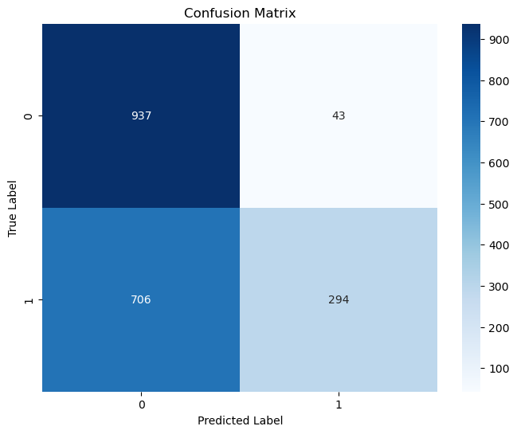
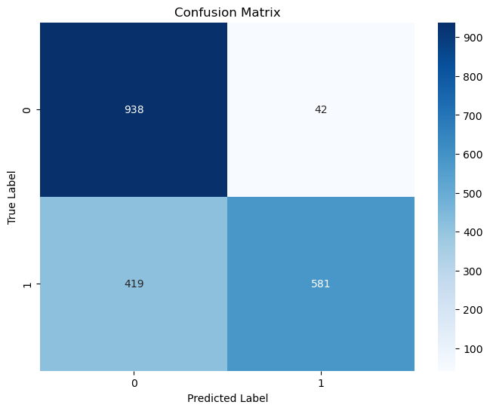
Results - IO Detection
Figure 4. Ada 0’s Confusion Matrix when predicting RNA (trained on REA)
Figure 5. Ada 1’s Confusion Matrix when predicting RNA (trained on REA+CNHU)
Notes:
Ada 1 outperforms Ada 0

Slide 9
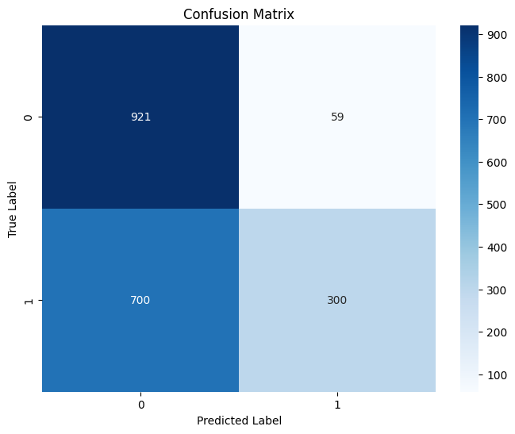
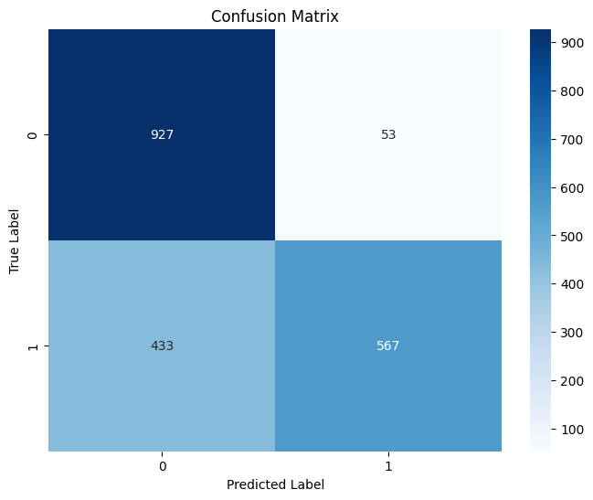
Results - IO Detection
Figure 5. BERT 0’s Confusion Matrix when predicting RNA (trained on REA)
Figure 6. BERT 1’s Confusion Matrix when predicting RNA (trained on REA+CNHU)
Notes:
And So does BERT1 in contrast to BERT0
These results suggest that these models perform better when trained on more operations even though the data with multiple operations is significantly smaller.

Slide 10
Conclusion/Discussion
Clustering:
Overarching themes among clusters.
Number of clusters is unclear.
Themes depend on sampled tweets.
Classification/IO Detection:
Models are more effective at predicting non-IO tweets than at predicting IO tweets
Potentially due to the noisy nature of tweets belong to IO accounts (can contain a large amount of trivial content)
Both Ada’s and BERT’s performance on a novel test set improves with a more diverse training set, despite the smaller size.
Training on more operations could be more effective towards detecting novel operations.
Notes:
In conclusion,
These results suggest that the models are more effective at predicting tweets from non-IO in comparison to the IO tweets
This could account for the noise of tweets by IO accounts
There is improved performance in Both Ada and BERT on a novel test set featuring multiple operations even if it is smaller
That could suggest that training on more operations could be more effective especially in detecting novel operations
When generalizing a new operation, BERT1 performs better than BERT0. BERT1 is trained on two operations while BERT0 is only trained on a single operation. This could be because the model that is trained on more operations could learn to detect the information operations in tweets better.
In a real world setting, potential IO tweets are often mixed sporadically among the random tweets posted on the internet.

Slide 11
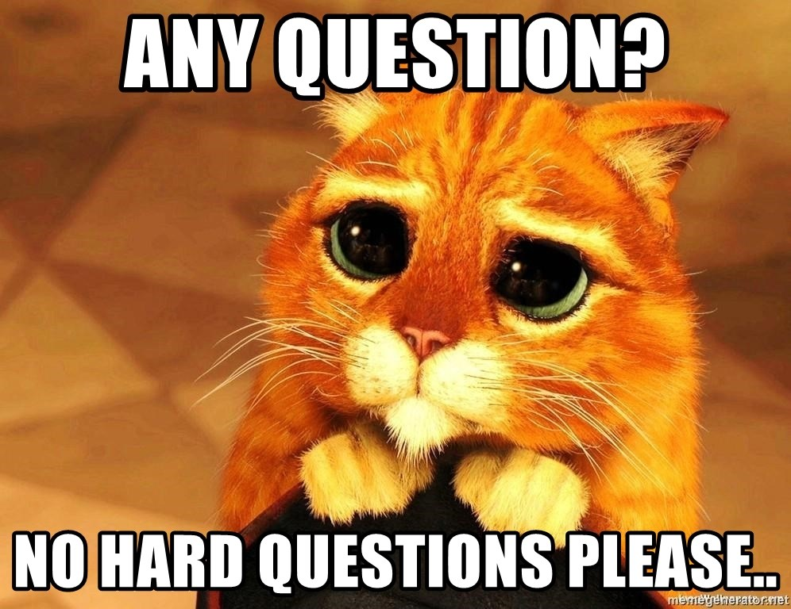
Thank you.

